Slide 1
Week 10
Uses and abuses of data, ui/ux

Slide 2
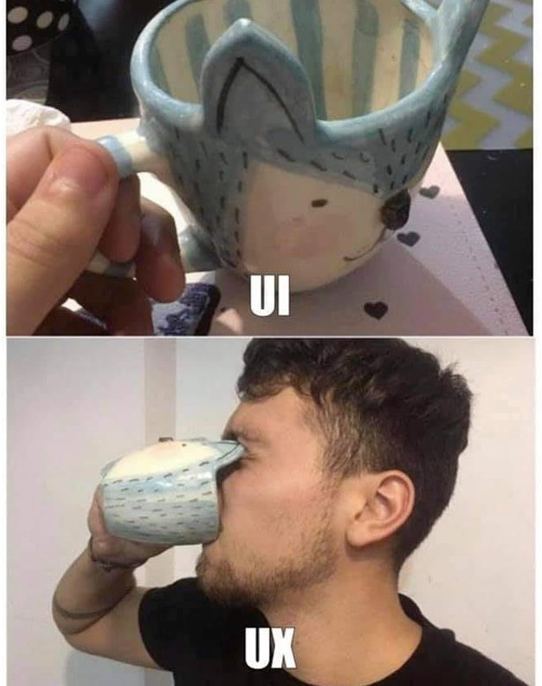
Reminder of UI/UX
UI is User Interface and it's how people interact with your data or product
UX is User Experience and how people feel about the interaction
We want to be able to share our data, our results and our analysis with others. To be able to do this successfully we have to pay attention to UI, UX and other types of visualizations
Well-designed user interactions with our data and results mean others want to interact with them more, greater understanding of the data and results, and can lead to better choices being made

Slide 3
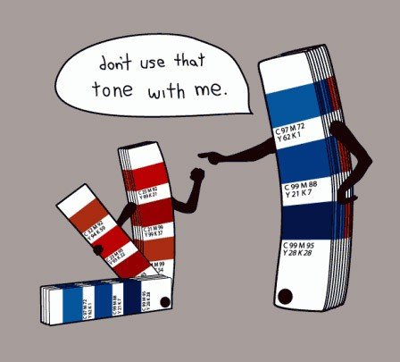
What makes good UI/UX
Understanding of your target market will help you understand what they need and want so your design can meet them where they are
Having a clear user journey, understand how they will go through your UI/UX/visualization including what touchpoints (specific cases that are important in your scenario) are important. Think of a treasure map with landmarks
Responsive design that is easy to navigate on all screen sizes
Accessibility is for everyone, better designs should make accessibility part of the interaction seamlessly
Simplicity, ease of use and intuitive navigation and understanding are key to good UI/UX/visualizations

Slide 4
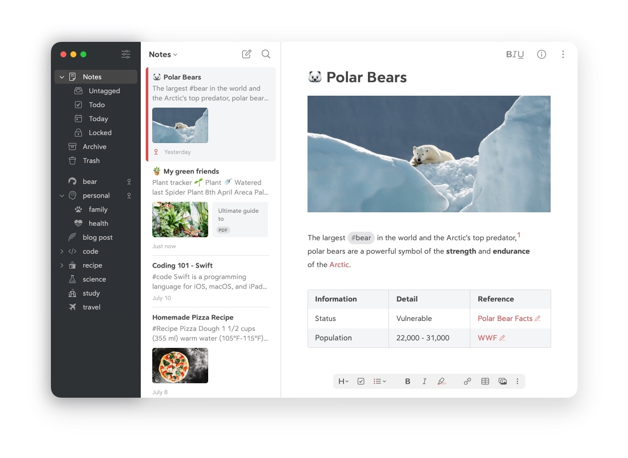
Examples of good UI/UX
https://bear.app/ a markdown note taking app
Some common examples of UI/UX that are considered intuitive
Netflix
Spotify
Bumble
Google Store
There are awards for good UI/UX
webby(https://winners.webbyawards.com/winners/websites-and-mobile-sites/features-design/best-user-experience?years=0) for websites
More general UX the UX designers awards https://ux-design-awards.com/winners?grouped=&search=&filter=&year=
More examples of designs can be found https://dribbble.com/

Slide 5
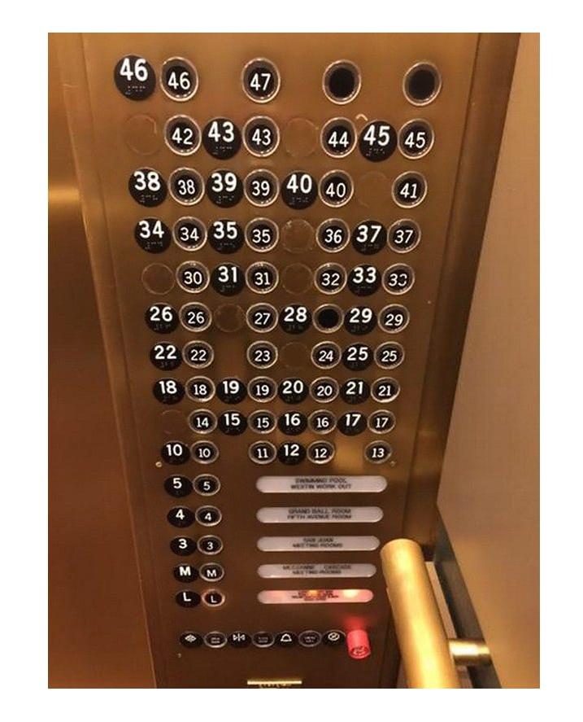
What makes bad UI/UX
Not paying attention to your target market and always doing the same thing, and presenting everything in the same way. A pie chart is great, ONLY using pie charts is not
Having no plan, hard to navigate interactions, and lots of clicks to get where you want to be
Confusing diagrams of the analysis that are hard to follow, not paying attention to how things look to others, for example a chart or website all in shades of red would be hard to use, tough for people with colour blindness, and not intuitive to navigate

Slide 6
Examples of bad UI/UX
I'm sure everyone can think of examples of times where you tried to use a product, navigate a website, play a game, or anything else where it was such a confusing and bad experience you gave up. Therefore we'll look at humorously bad options
Reddit has a whole subreddit for bad UI https://www.reddit.com/r/badUIbattles/
Some designers have implemented collections of these https://goulartnogueira.github.io/BadUI/
Challenge: Fill out this form as fast as you can https://userinyerface.com/

Slide 7
How UI/UX can affect how data is used and seen
Part of UI/UX is organization and consistency, if your data isn't organized it's hard to use
Think of adding in a birthday to a website, you expect the dates to be in order right? What if they weren't?
If you give too much data and information to a user right away, you will overload them and they won't get much out of it
Think of my TL;DR videos at 20min, vs if I recorded a two hour lecture for you to listen to
If your interface is confusing and frustrating, even if the user powers through because they have to, they won't get as much out of it, and if they misunderstand what you're trying to convey you'll lose their trust and they won't listen/read/see/understand what you want them to

Slide 8
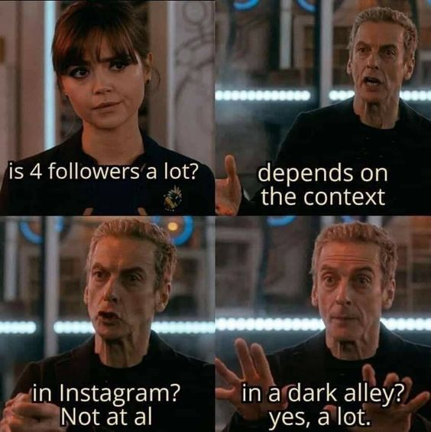
How and why people can manipulate data
Data can show anything you want
Example, US is best at Football! 100% of Superbowls are won by US teams! Are you impressed by that? Is the US the best? No? Why not? Did you make a face and say something about American football and not REAL football
Showing the right data (or the wrong data) can change how people view things
If you can understand what data to collect and how it influences choices you can choose where to press
Dark Patterns are unfortunately a common thing, especially in social media. But the ability to subtly press people into things using data has been used for many years for good things (eating vegetables during WWII) or bad things (Doom scrolling)

Slide 9
Examples of people manipulating data
Data profiling
Based on data collected about you, should you get ads to push your vote one way? Encourage you not to vote? Show you lies or exaggerations about the opposing party?
What is most likely to make you want to interact with a post? Something you agree with a little? Or something you REALLY hate?
Dark Patterns
Have you ever felt like you accidentally bought something? Signed up for a reoccurring bill that you didn't mean to?
Tricky wording and hiding information is common, think of the unsubscribe button on emails
Some examples of these are HP ink cartridge subscriptions that stop your printer from working when they run out, or apps that trick you into uploading your address book
https://www.deceptive.design/

Slide 10
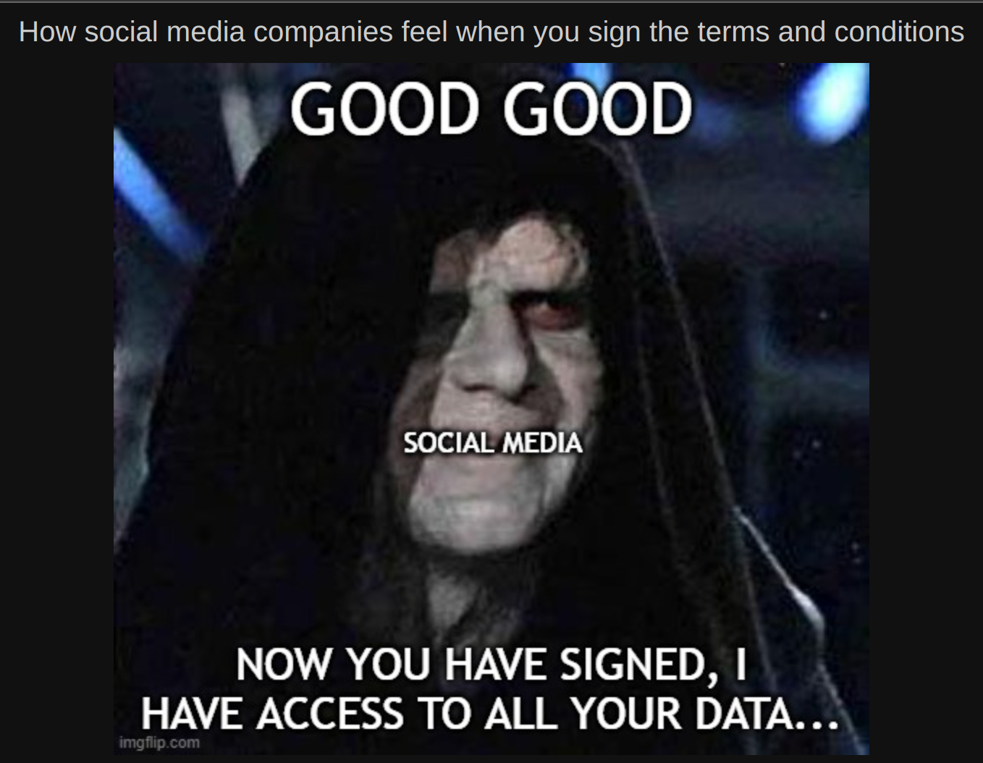
Current industries where data abuse is rampant
Social Media
Healthcare that isn't (DNA databases)
Banks that aren't (Things that appear to be insured banks but aren't)
User-to-user payment or investing services
Internet Service Providers (ISPs)
Large conglomerates such as Microsoft , Amazon and Google
For-profit educational institutions

Slide 11
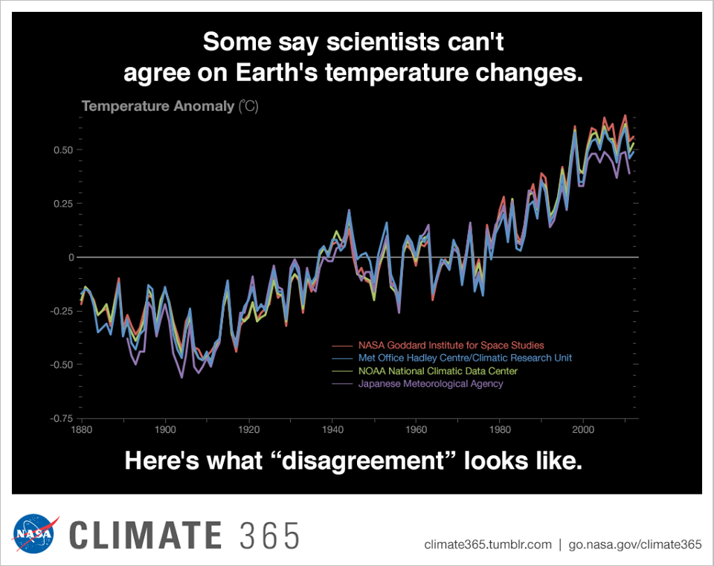
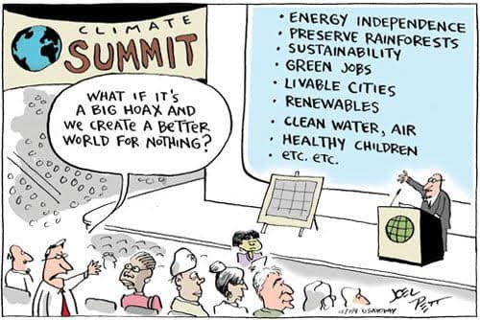
Examples of where data is used for common good
Hygiene, hand washing is a relatively new concept as are germs. Even as late as the 1840s hand washing for medical professionals was seen as weird and not needed
Health of a nation, cigarettes were seen as "healthy" as little as 100 years ago and recommended by doctors even for people with Asthma. Data has shown that they are not healthy
Climate change

